Slide 1
Unit Testing Concepts

Slide 2
Objective
Beginners acquaintance to low-level testing.

Slide 3
We discuss about…
V Model
Testing concepts
Low-level Testing or Unit testing
Testing tools

Slide 4
“V” model
Proposal / Requirements study phase
Acceptance test planning
Acceptance testing
System test planning
Requirement analysis
System testing
High Level design
Integration test planning
Integration testing
Unit test planning
Detailed design
Unit testing
Implementation/Coding

Slide 5
Testing Concepts
Objective of Software Testing
To demonstrate that the software satisfies its requirements
To demonstrate with a high degree of confidence that errors which could lead to unacceptable failure conditions, as determined by the system safety assessment process, have been removed.

Slide 6
Testing Concepts
BLACK BOX testing
Module under test is treated as a black box (without seeing the code), to which input is applied and corresponding output is verified i.e only functionality is checked

Slide 7
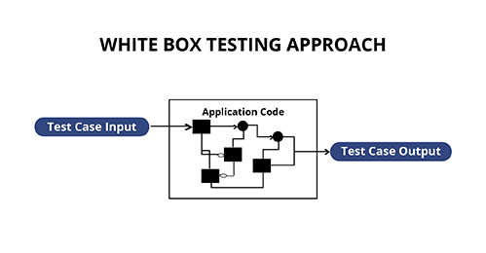
White Box Testing
White Box Testing is software testing technique in which internal structure, design and coding of software are tested to verify flow of input-output and to improve design, usability and security.
In white box testing, code is visible to testers so it is also called Clear box testing, Open box testing, Transparent box testing, Code-based testing and Glass box testing.

Slide 8
White Box Testing…
White box testing involves the testing of the software code for the following:
Internal security holes
Broken or poorly structured paths in the coding processes
The flow of specific inputs through the code
Expected output
The functionality of conditional loops
Testing of each statement, object, and function on an individual basis

Slide 9
Advantages of White Box Testing
Code optimization by finding hidden errors.
White box tests cases can be easily automated.
Testing is more thorough as all code paths are usually covered.
Testing can start early in SDLC even if GUI is not available.

Slide 10
Disadvantages of White Box Testing
White box testing can be quite complex and expensive.
Developers who usually execute white box test cases detest it. The white box testing by developers is not detailed can lead to production errors.
White box testing requires professional resources, with a detailed understanding of programming and implementation.
White-box testing is time-consuming, bigger programming applications take the time to test fully.

Slide 11
Phases of Testing
CSCI
Validation Testing
Integration Testing
CSC
CSC
CSC
CSU
CSU
Unit Testing
CSU

Slide 12
CSCI(Computer Software Configuration Item)
A group of software treated as a single entity.
CSC(computer software component)
A functional or logically distinct part of a Computer Software Configuration Item (CSCI) or Software Configuration Item (SCI). A CSC is typically an aggregate of two or more Computer Software Units (CSUs).
CSU(Computer Software Units)
The smallest subdivision of a Computer Software Configuration Item (CSCI) for the purposes of engineering management. CSUs are typically separately compilable pieces of code.

Slide 13
Low-Level Testing
Unit testing is the process of testing the functionality of the lowest entity with respect to the design, isolating entity from the system by means of simulating all other external interfaces of the entity.
Sim. interface2
Sim. interface3
Sim. interface1
Unit
under test or CSU
Sim. interface N

Slide 14
Low-Level Testing
Requirement tests
Based on Software Design Document (SDD) requirements;
functionalities of the component and the limit values of data are tested.
Robustness tests
CSU functioning in case of data values out of range, or the
abnormal CSU environment (information that are not given in the SDD document).

Slide 15
Low-Level Testing
Examples for robustness tests.
To verify the component behavior by using a division by 0, in case this behavior is not specified in the SDD document
To verify the component behavior in front of an overflow for a local data or an impossible operation (negative square root), in case this behavior is not specified in the SDD document
3) To verify the component capabilities to use incorrect input data : value out of range for input and input/output data (parameters and global variables), if this range is not described in the SDD document.

Slide 16
Low-Level Testing
Detailed Design(SDD)
Unit Test
Test Report
+ Coverage Report
input
process
output
Low-Level Testing is
Testing the lowest level entity (Most independent i.e CSU) within its boundaries
Covers the functionality of the module and at the same time tests its robustness

Slide 17
Low-Level Testing
Code
Unit Test
Useless
Input
Test process
Output
The main input for a tester to perform unit test is
Software Design Document and not the source code.
Why not with code as input?
With code as input, the requirements are not tested and mismatch between detailed design & code cannot be detected

Slide 18
Importance of robustness tests
Detailed Design:
Swap the values of two integer variables A and B ( where A,B holds half the magnitude of its type )
a
b
c
d
e
A=A+B
B=A-B
A=A-B
A=A-B
B=B+A
A=B-A
A=A*B
B=A/B
A=A/B
A=A/B
B=A*B
A=B/A
Temp=A
B=A
A=Temp
Irrespective of the kinds of algorithm used, the function it does is swapping values of two variables.
One of the inputs and expected output of this requirement is
I/p -> A=10, B=5 and O/p -> A=5, B=10 ( Testing within boundaries )

Slide 19
Importance of robustness tests
a
b
c
d
e
A=A+B
B=A-B
A=A-B
A=A-B
B=B+A
A=B-A
A=A/B
B=A*B
A=B/A
A=A*B
B=A/B
A=A/B
Temp=A
B=A
A=Temp
Consider code “C”.
Give I/p -> A=10, B = 0 O/p -> ??
Divide by zero error…..!!
Code ( ‘C’ or ‘D’ ) is not ROBUST -> functionality is not implemented for all the possible values of inputs.

Slide 20
Summary…
V model
Testing concepts
Phases of Testing ( Hierarchy )
Black box and white box Testing
Low-Level or Unit Testing
Low-level Testing concepts…
Testing the functionality of code with design
Checking for the boundaries
Importance of robustness tests

Slide 21
Testing tools
Some of the Unit Testing tools
C RTRT,Cantata, VectorCAST, MinUnit, CTB etc.
C++ RTRT, Cantata, VectorCAST, C++Test, CTA++, CppUnit etc.
ADA RTRT, AdaTEST, VectorCAST, TBGEN, Aunit etc.

Slide 22
Testing tools
Test script
Test Report
Test tool
Source code
Coverage Report
optional
Test script or Test Plan : Consists of testers inputs to the parameters and expected results. This script is processed by the tool and converted into a driver, driving the source. In RTRT, the name is given as <name>.ptu
Test Report : Results of the test execution, whether passed or failed.
Coverage Report : How much of the total source code have been covered by all the test cases.

Slide 23
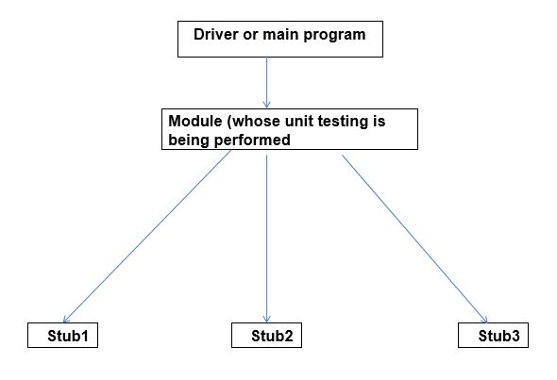
Stub Definition
Stubs are simulated implementations of functions that cannot be run in the testing environment, or functions for which the user wishes to give an alternative implementation for testing purposes.

Slide 24
What is Code coverage?
Code coverage is a measure which describes the degree of which the source code of the program has been tested.
It is one form of white box testing which finds the areas of the program not exercised by a set of test cases.
It also creates some test cases to increase coverage and determining a quantitative measure of code coverage.

Slide 25
Types of coverage?
Statement Coverage
Decision Coverage
Branch Coverage
Condition Coverage
Modified condition/ Decision coverage(MC/DC)
Loop coverage

Slide 26
Statement Coverage
How much of the total executable statements have been hit (covered) by the various test case scenarios.
The main purpose of Statement Coverage is to cover all the possible paths, lines and statements in source code.
{
Stat 1;
Stat 2;
If <cond>
Stat 3;
End if;
}
In the given piece of code block, if condition is false then 2 out of 3 statements are said to be covered.
100% coverage can be achieved by writing a test case, with the condition being true.
Note :
This kind of if statement without else part is referred as implicit if.
If any piece of code cannot be covered by any means then it is called ’DEAD code’

Slide 27
Example for statement coverage
Source Code:
Prints (int a, int b) { ------------ Printsum is a function
int result = a+ b;
If (result> 0)
Print ("Positive", result)
Else
Print ("Negative", result)
} ----------- End of the source code

Slide 28
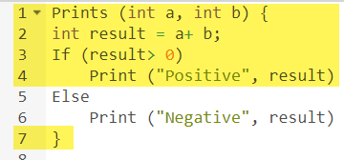

Test Case 1 :
The statements marked in yellow color are those which are executed as per the scenario
Number of executed statements = 5, Total number of statements = 7
Statement Coverage: 5/7 = 71%
If a = 3, b = 9

Slide 29
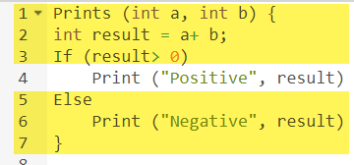

Case 2 :
The statements marked in yellow color are those which are executed as per the scenario.
Number of executed statements = 6
Total number of statements = 7
Statement Coverage: 6/7 = 85%
If a = -3, b = -9

Slide 30

Example for statement coverage…
But overall if you see, all the statements are being covered by 2nd scenario’s considered. So we can conclude that overall statement coverage is 100%.
What is covered by Statement Coverage?
Unused Statements
Dead Code
Unused Branches
Missing Statements

Slide 31
Decision Coverage
For a decisive statement both true and false conditions should be tested ( even if the decision statement is of implicit form ).
The goal of decision coverage testing is to cover and validate all the accessible source code by checking and ensuring that each branch of every possible decision point is executed at least once.
If the condition is true then 1 out of 2 decisions has been covered.
To achieve 100% decision coverage both true and false conditions have to be achieved in two different test scenarios, even though the statement is of ‘implicit if‘ form.
{
Stat 1;
Stat 2;
If <cond>
Stat 3;
End if;
}

Slide 32
Example for Decision Coverage
Source Code:
Demo(int a)
{
If (a> 5)
a=a*3;
Print (a);
}

Slide 33
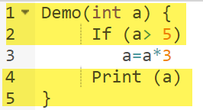

Case 1 :
Value of a is 2
The code highlighted in yellow will be executed. Here the “No” outcome of the decision If (a>5) is checked.
Decision Coverage = 50%

Slide 34
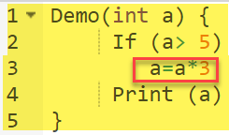
Case 2 :
Value of a is 6
The code highlighted in yellow will be executed. Here the “Yes” outcome of the decision If (a>5) is checked.
Decision Coverage = 50%
Test Case | Value of A | Output | Decision Coverage
1 | 2 | 2 | 50%
2 | 6 | 18 | 50%

Slide 35

Branch Coverage
The purpose of branch coverage is to ensure that each decision condition from every branch is executed at least once.
For example, if the outcomes are binary, you need to test both True and False outcomes.

Slide 36
Example of Branch Coverage
Consider the following code:
Demo(int a)
{
If (a> 5)
a=a*3
Print (a)
}

Slide 37
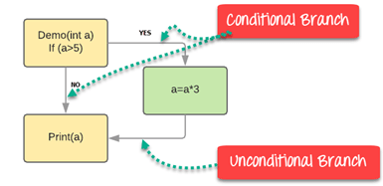
Example of Branch Coverage

Slide 38
Example of Branch Coverage…
Branch Coverage will consider unconditional branch as well
Case 1: Case 2:
Test Case | Value of A | Output | Decision Coverage | Branch Coverage
1 | 2 | 2 | 50% | 33%
2 | 6 | 18 | 50% | 67%

Slide 39
MC/DC – Modified condition/ Decision coverage
Independence : Consider the following conditional statement,
If ( ( A and B ) or C ) then
(…)
Else
(…)
End if
Consider (A and B )
A B Result
True True True
True False False
False True False
False False False
Consider ( E or C )
E C Result
True True True
True False True
False True True
False False False
A and B => E ( can be extended for E or C )
In the first 3 cases the result is dependent on any change in one of A or B. If either one of A or B changes its state, then the result changes.
Case 1: result is true because both A and B are true
Case 2: result is false only because B is false → change in B affects the o/p
Case 3: result is false only because A is false → change in A affects the o/p
Case 4: result is false. Even if A is toggled, the result is false and same for B.
This kind of test case (case 4) which proves nothing can be excluded.

Slide 40
MC/DC Definition…
Every point of entry and exit in the program has been invoked at least once, every condition in a decision in the program has taken all possible outcomes at least once, every decision in the program has taken all possible outcomes at least once, and each condition in a decision has been shown to independently affect that decision’s outcome. A condition is shown to independently affect a decision’s outcome by varying just that condition while holding fixed all other possible conditions.

Slide 41
MC/DC
Consider the case ( A and B ) or C
A B C Result
1. False True False False
2. True True False True
3. True False False False
4 True False True True
(1,2) Shows independency of A
(2,3) Shows independency of B
(3,4) Shows independency of C

Slide 42
While testing for MCDC…….
Determine states which prove Independence of conditions and choose the best combinations.
Number of MCDC test cases required for any combinational logic is ?
Number of unique conditions available + 1

Slide 43
Loop coverage
This ensures that every loop in the source code is executed at least once.
Three kinds of loop coverage criteria.
For( I=0; I < global_integer ; I ++ )
{ . . . }
In this case, at least three different values must be given to global_integer, so that the loop undergoes
0 iteration,
1 iteration
2 or more number of iterations
The loop coverage will be 3/3 ➔ 100%

Slide 44
Loop coverage
Note: Following is a static loop
For( I=0; I < 10 ; I ++ )
{ . . . }
This loop would not have 100% loop coverage since it cannot undergo 0 iteration and 1 iteration.
At any instant only 2 or more iterations are possible. So the loop coverage will be 1/3 ➔ 33.33%

Slide 45
What is requirements coverage?
Whether all the requirements are correctly implemented or not is the one and only objective.
100 % requirement coverage, means, all the requirements corresponding to the particular CSU or CSC or CSCI should have been tested for its correctness.
Scope of requirements testing extends from low-level to integration and system testing of the software system

Slide 46
Some Tips
Before starting the test, analyse the component based on the SDD()
Comments are very important in a unit test. It adds clarity on the test, and gives confidence to the reviewer on the functionalities covered by the test
All the data must be tested in each test case, except for local variables local to the source under test.
Test script must be easily understandable to others.
Report must have passed, if not it must be justified through defect records or problem reports.
Coverage for required level, must be 100% ( exceptions like loop coverage)

Slide 47
Test to BREAK the code
Thank you

